Slide 1
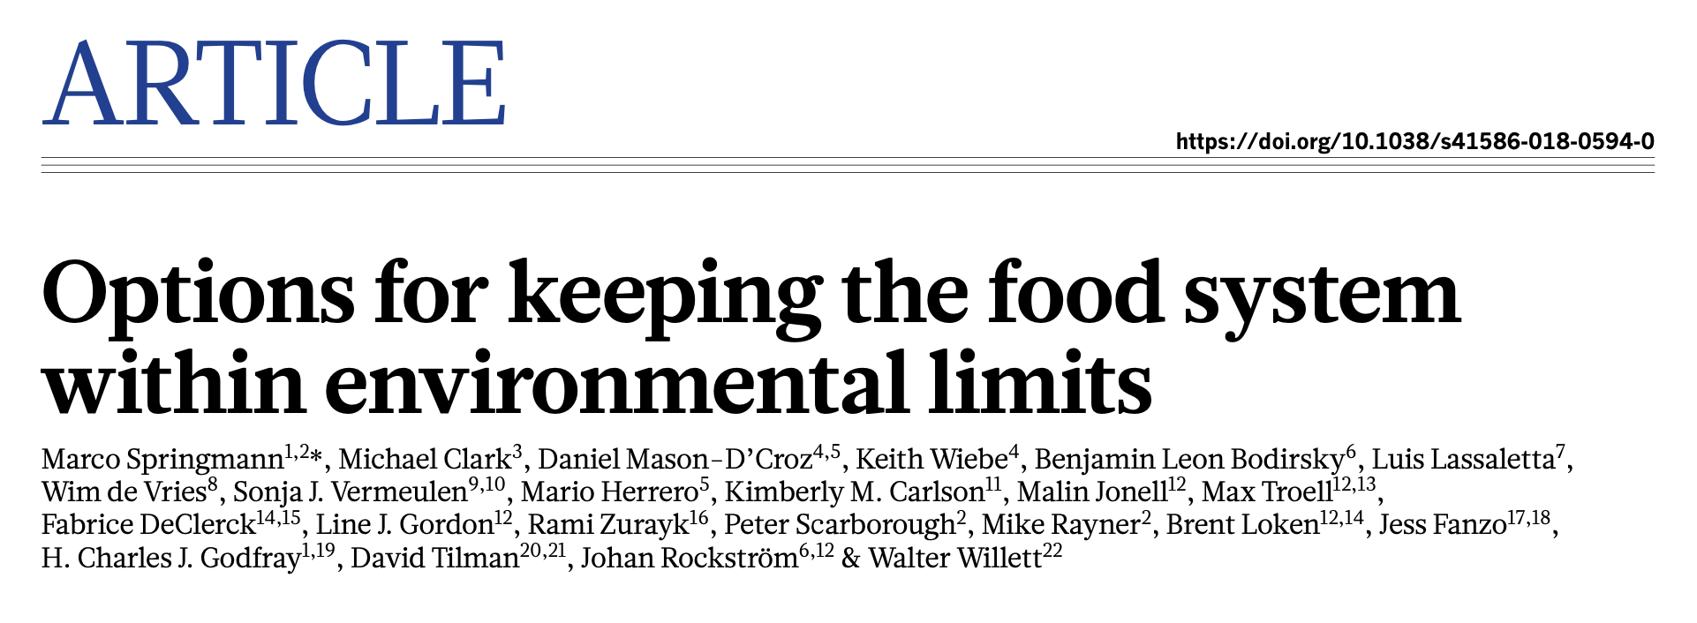

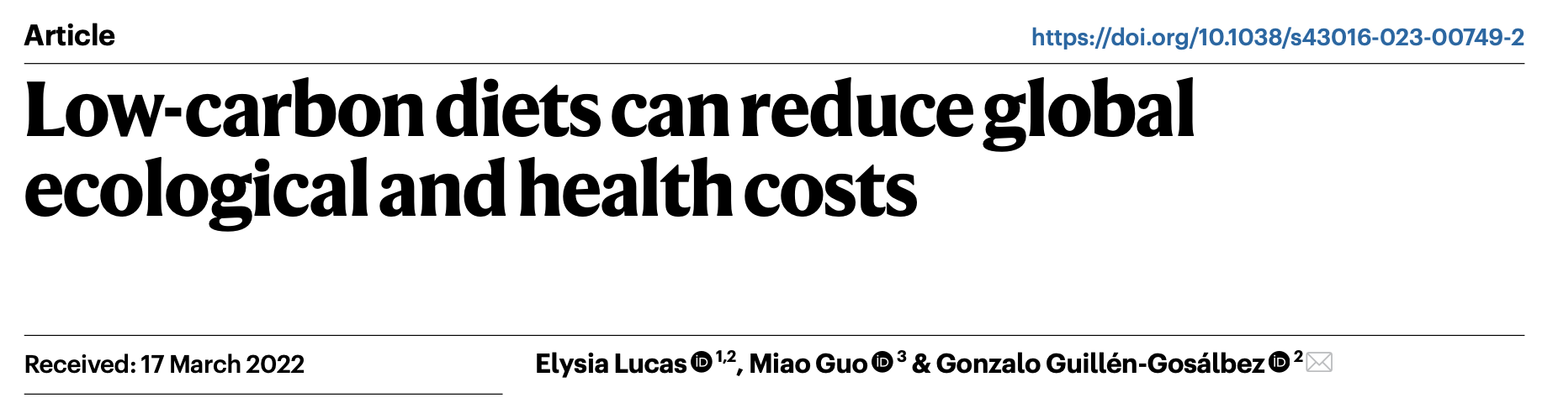
Journal club 2
40 minutes to read
5-10 minutes to present
What does the paper speak about and why does it matter ?
Methodology
Main results
Conclusion

Slide 2
Fig.1, Fig.2, Fig.3, Fig. 4 + ’Policy implications’ paragraph
BIG GROUP !
IPCC AR6 WG3 (SPM):
Context : B.1-B.2-B.3 + Fig. SPM.1 / Fig. SPM.2
Scenarii : C.1-C.2-C.3 + Box SPM.1 + Fig SPM.5.a
Mitigation: C.8-C.9-C.10 + SPM6, SPM.7
Fig. 3, Fig. 4 (or Extended data Fig.3), Fig. 5 and Fig. 6

Slide 4
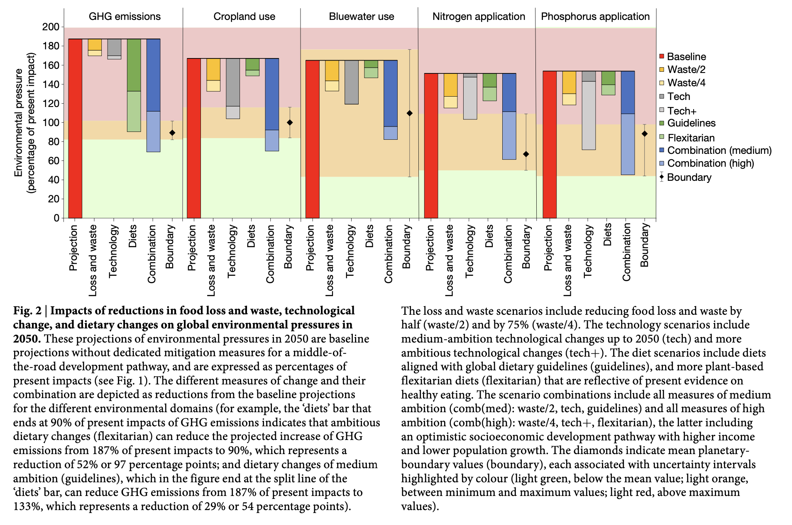

Slide 5
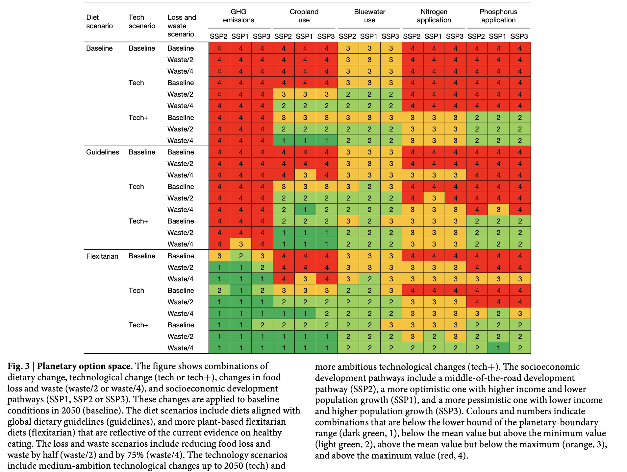

Slide 6
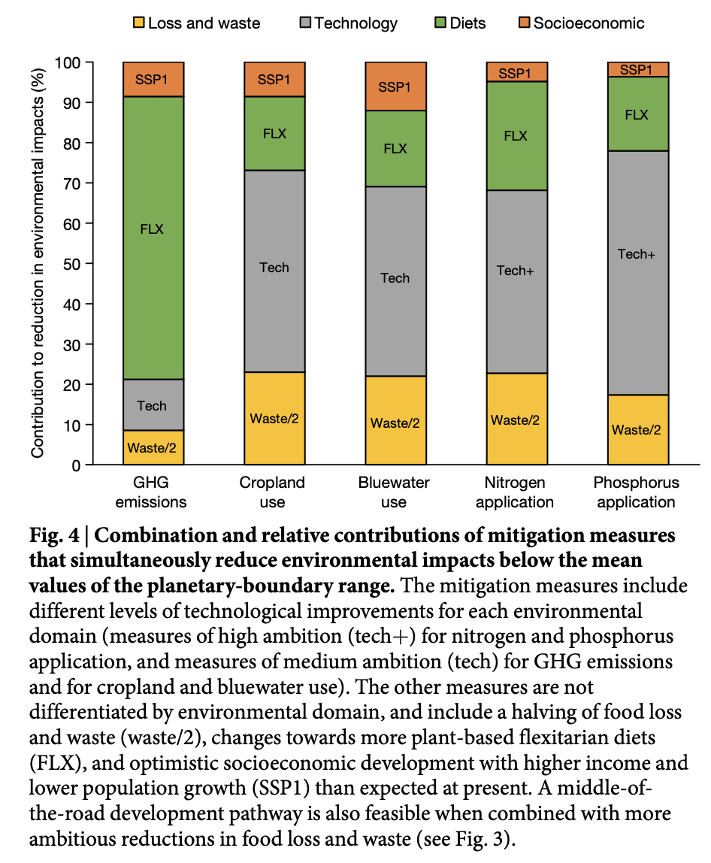

Slide 7


Slide 9
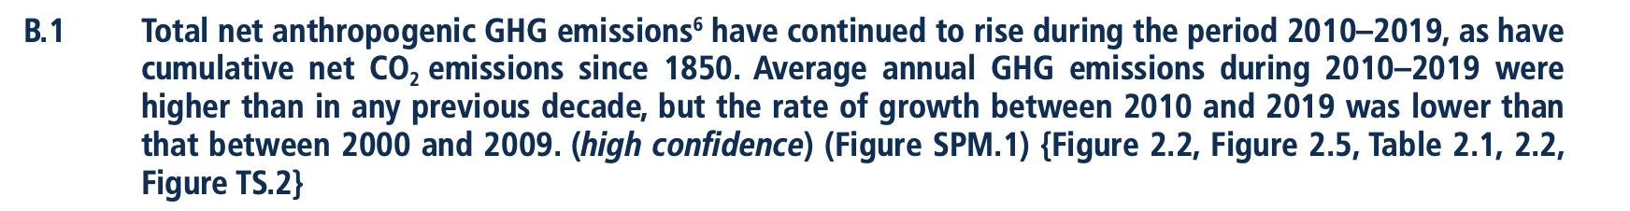
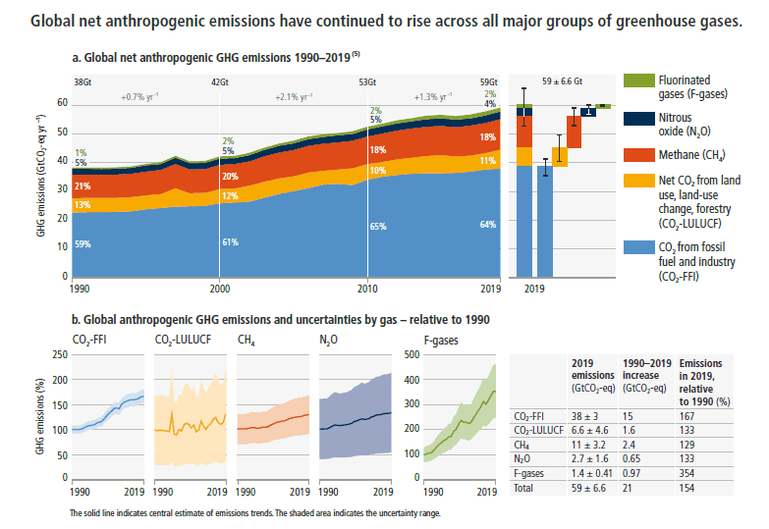

Slide 10
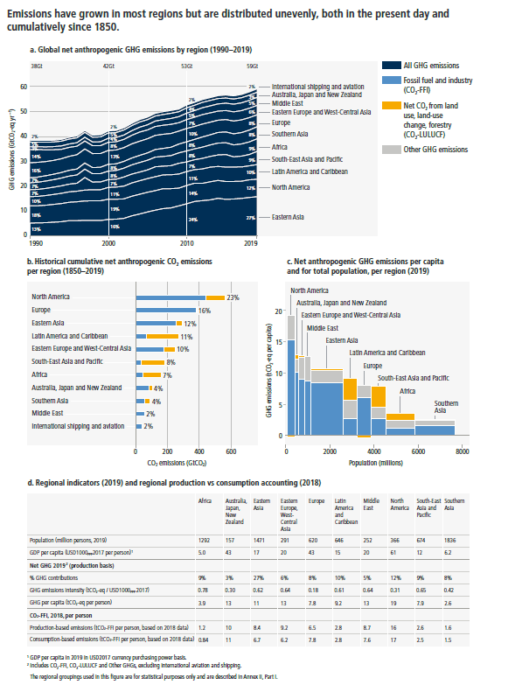
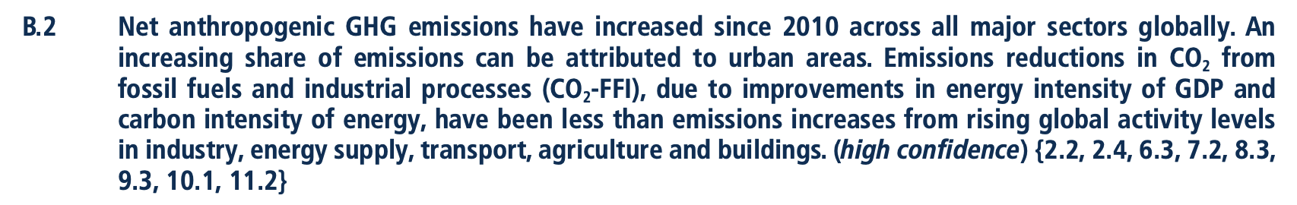
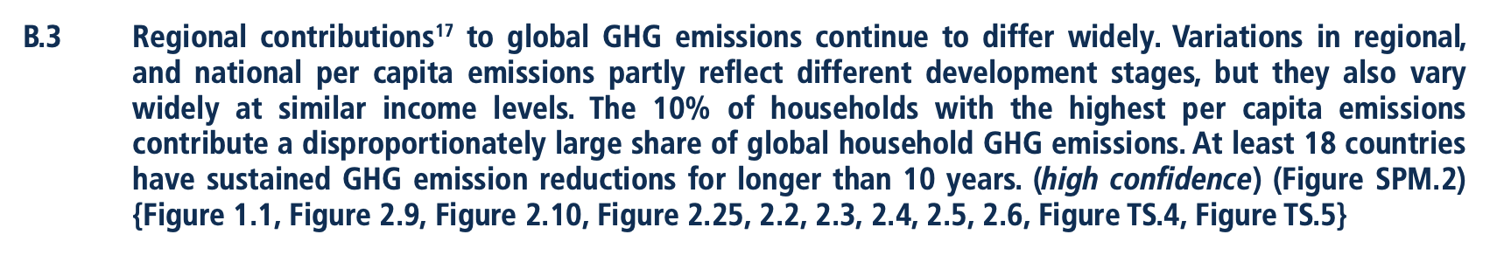

Slide 11
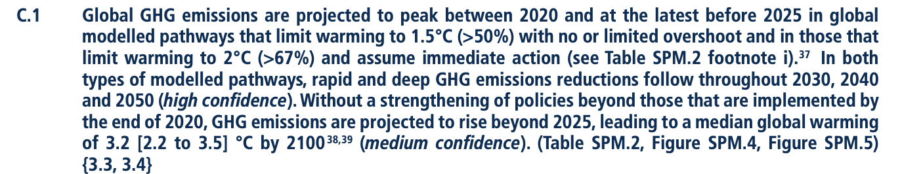
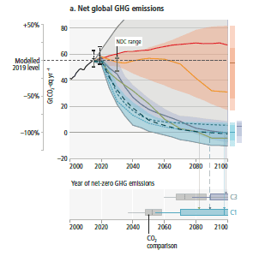
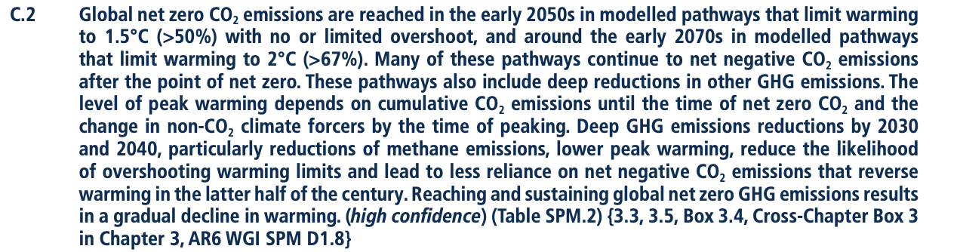
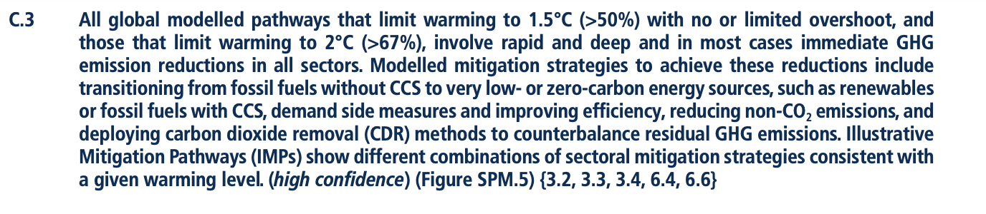

Slide 12
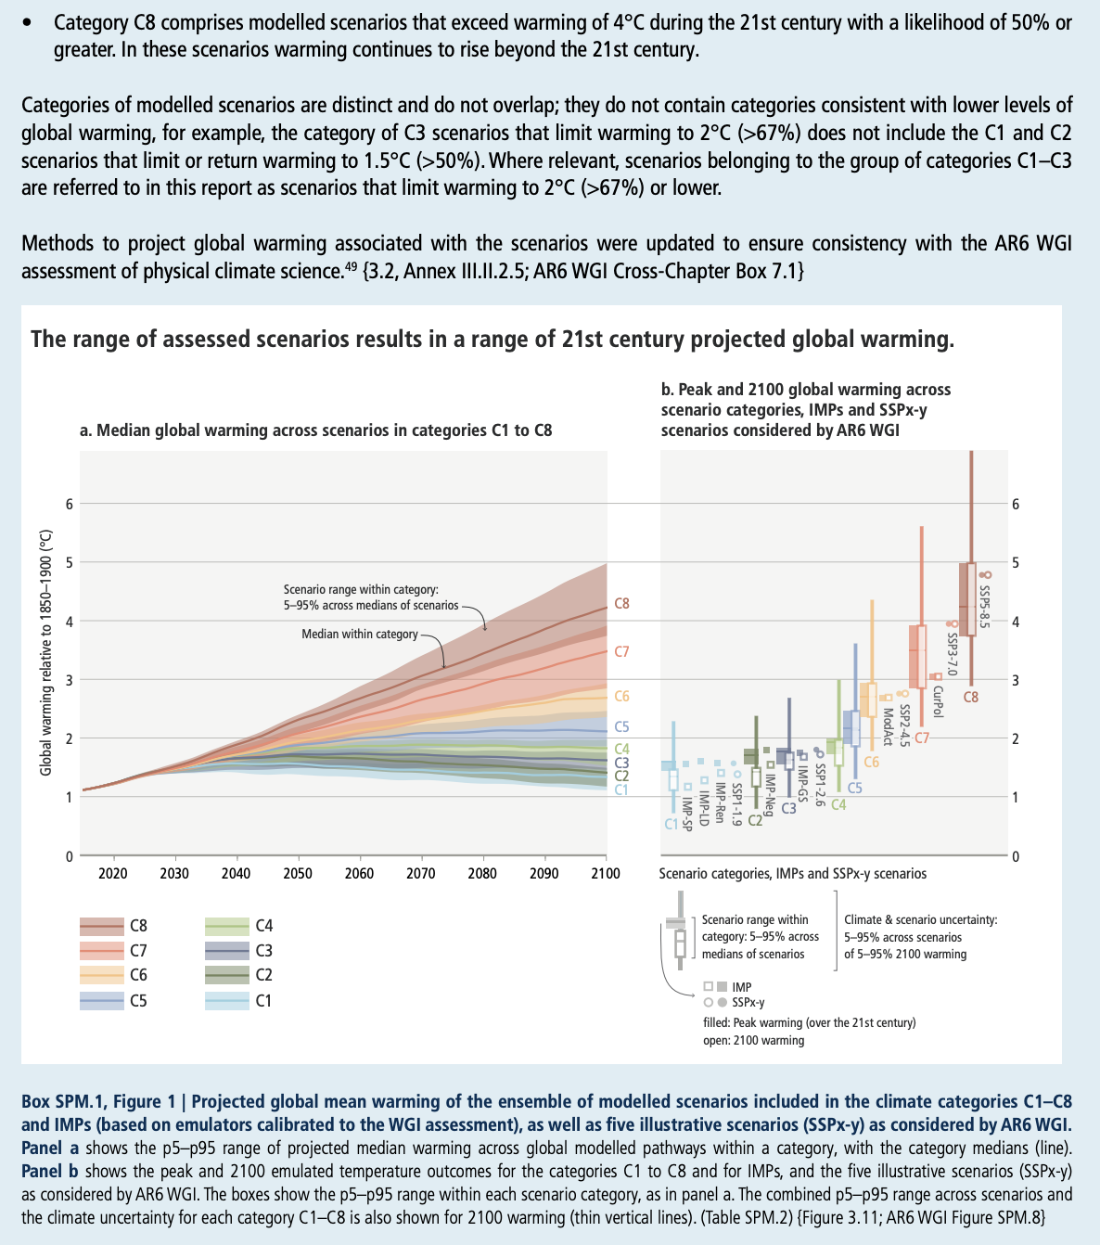
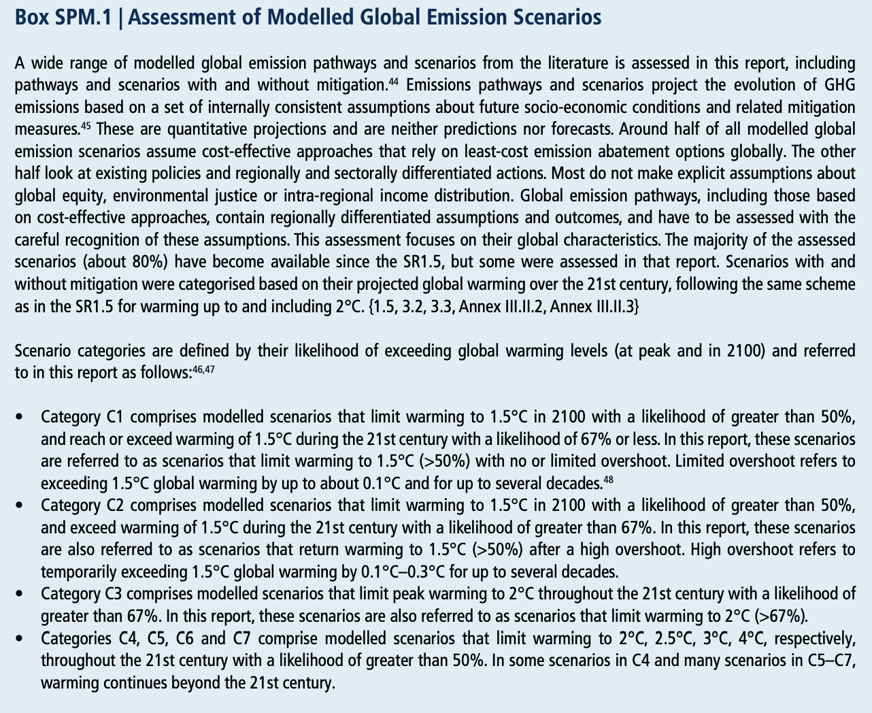

Slide 13
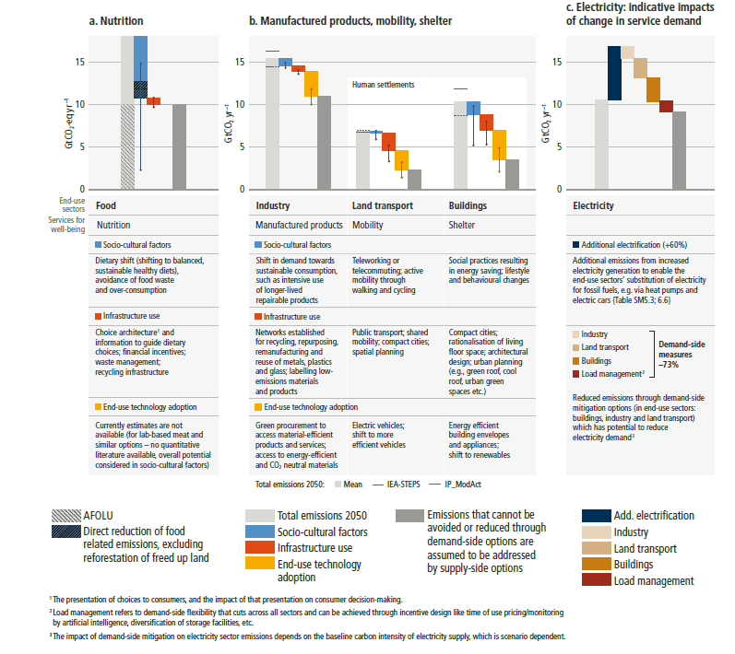
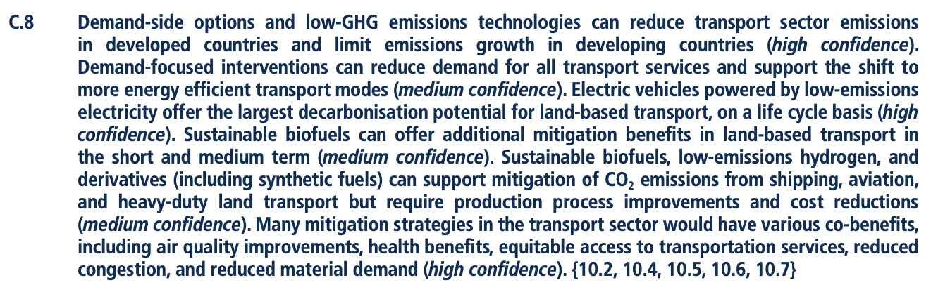
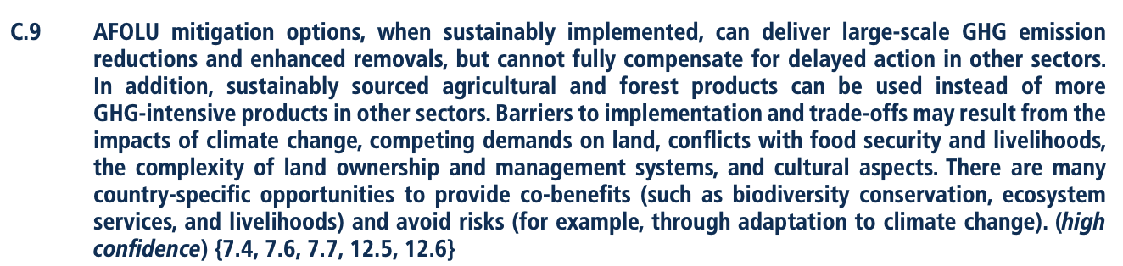
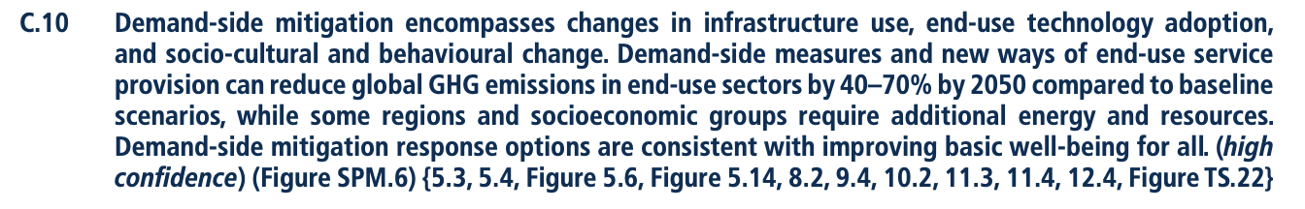

Slide 14
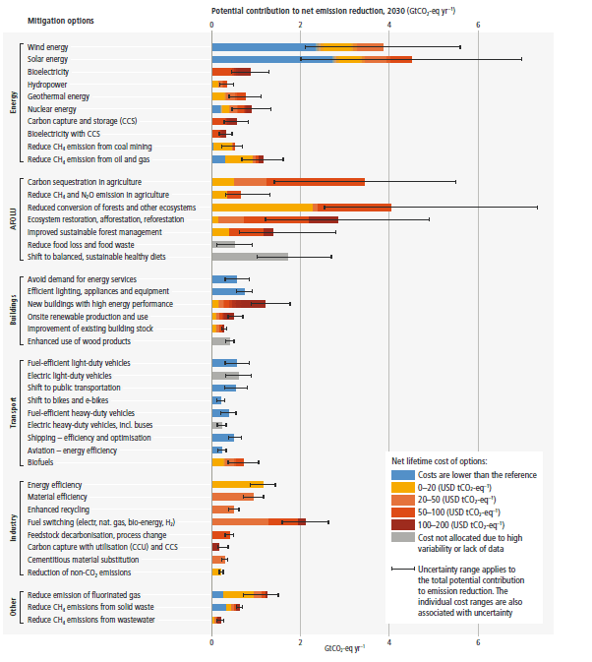
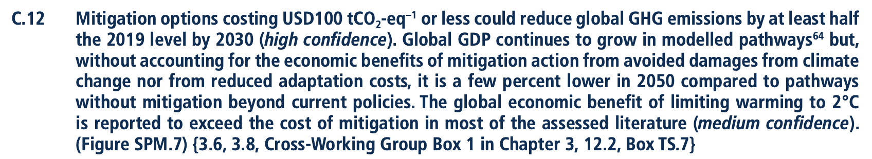

Slide 16
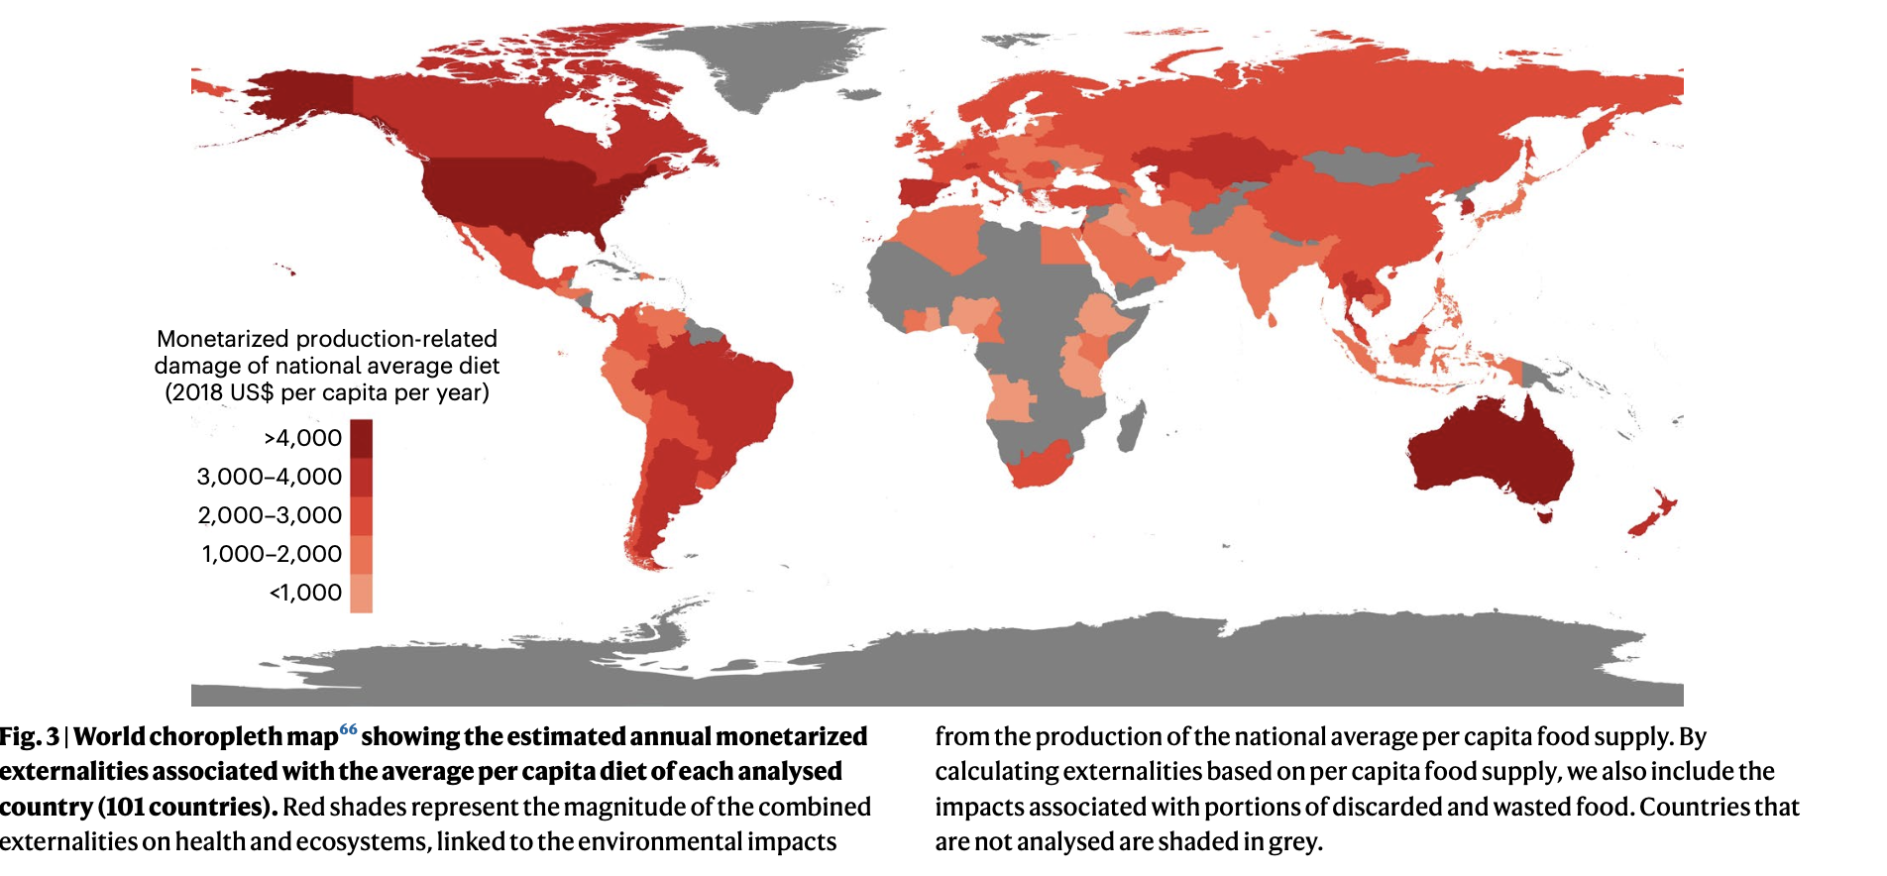

Slide 17
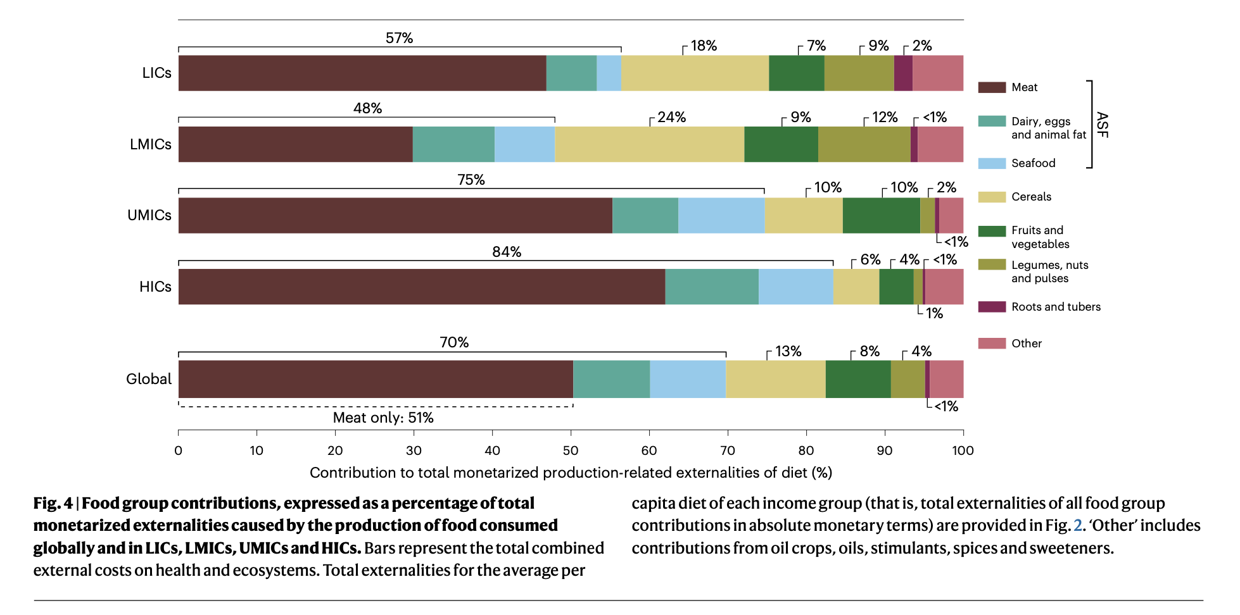

Slide 18
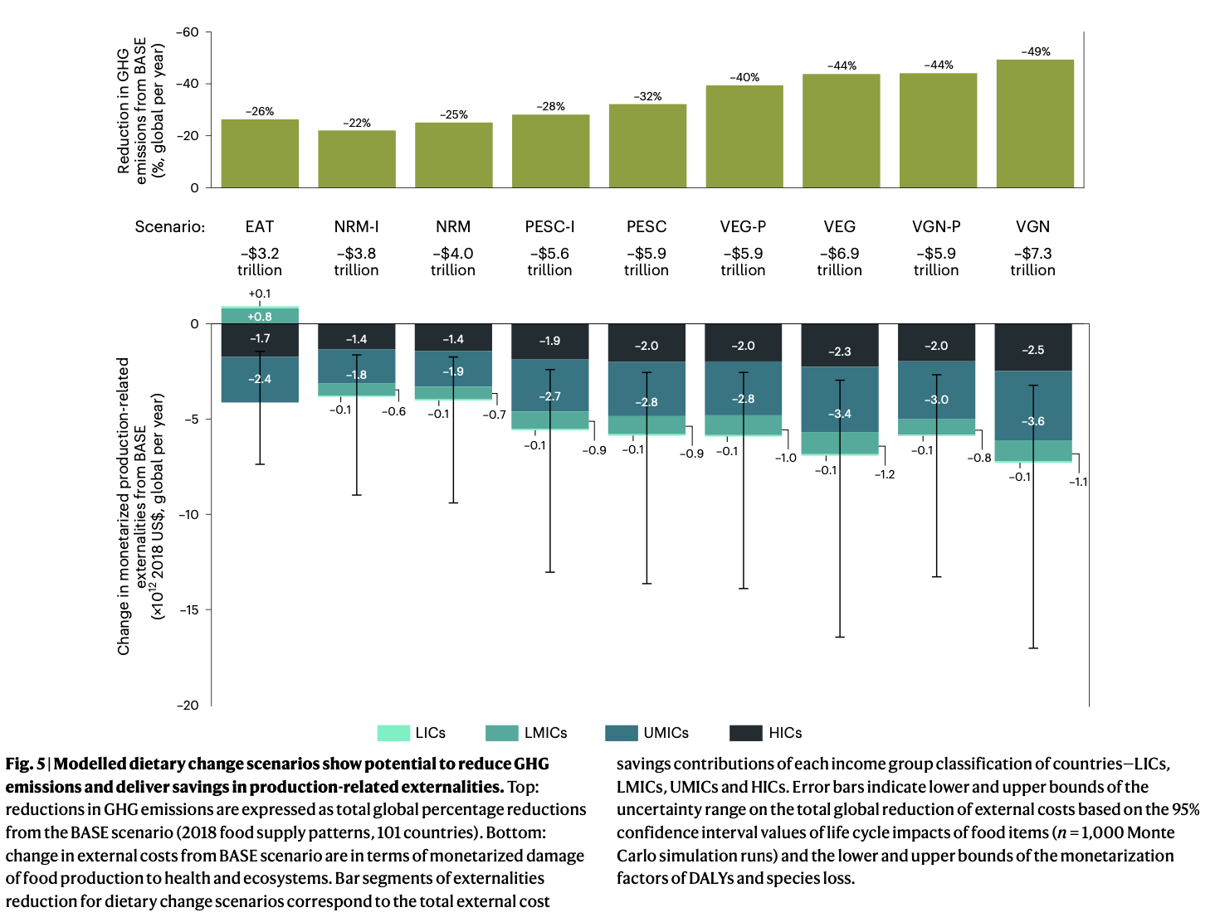

Slide 19
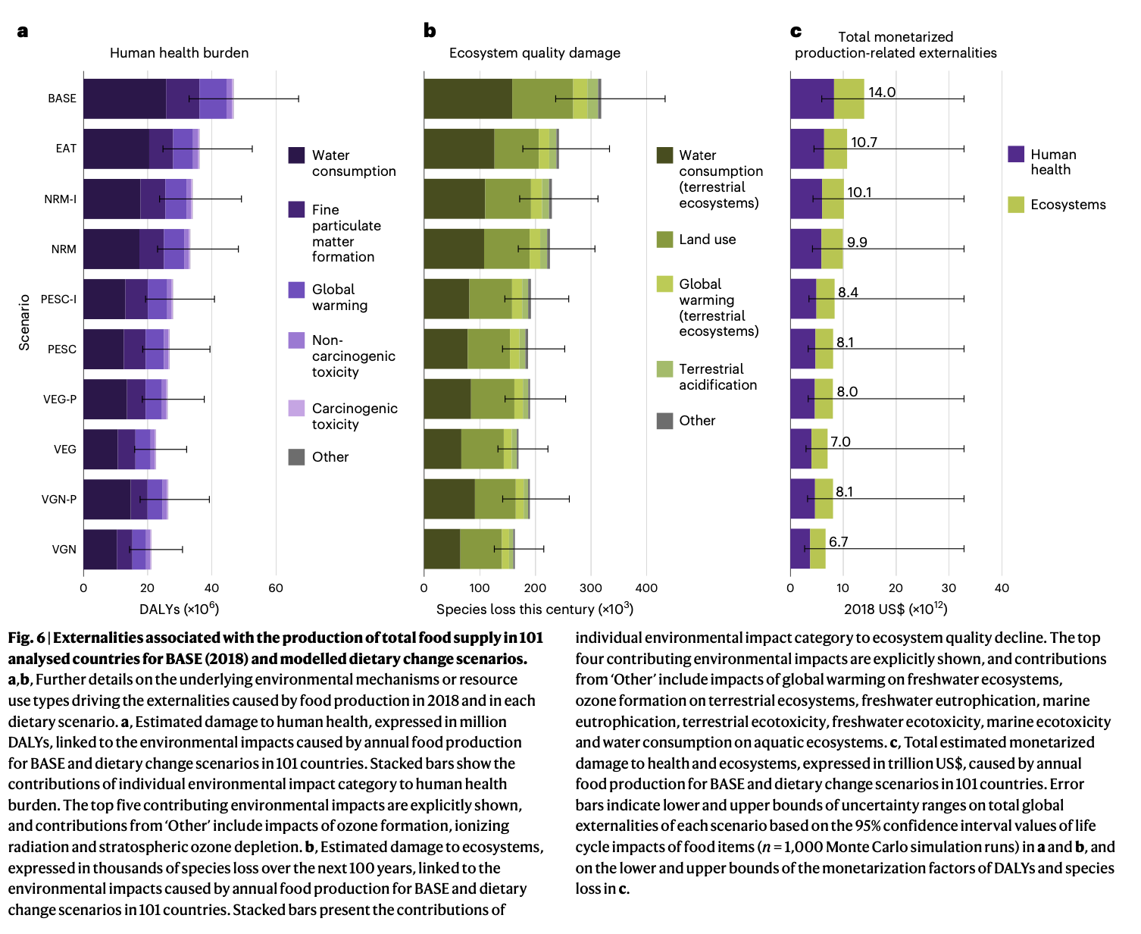

Slide 20
This paper is not covered in this year’s course, but FYI ;)

Slide 21
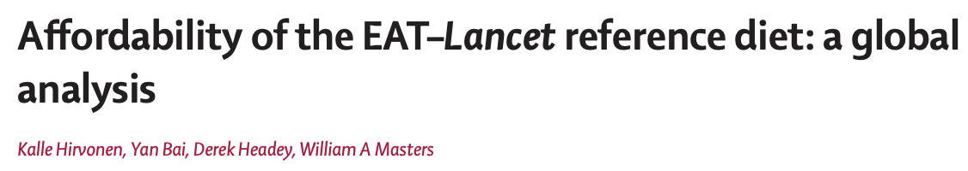

Slide 22
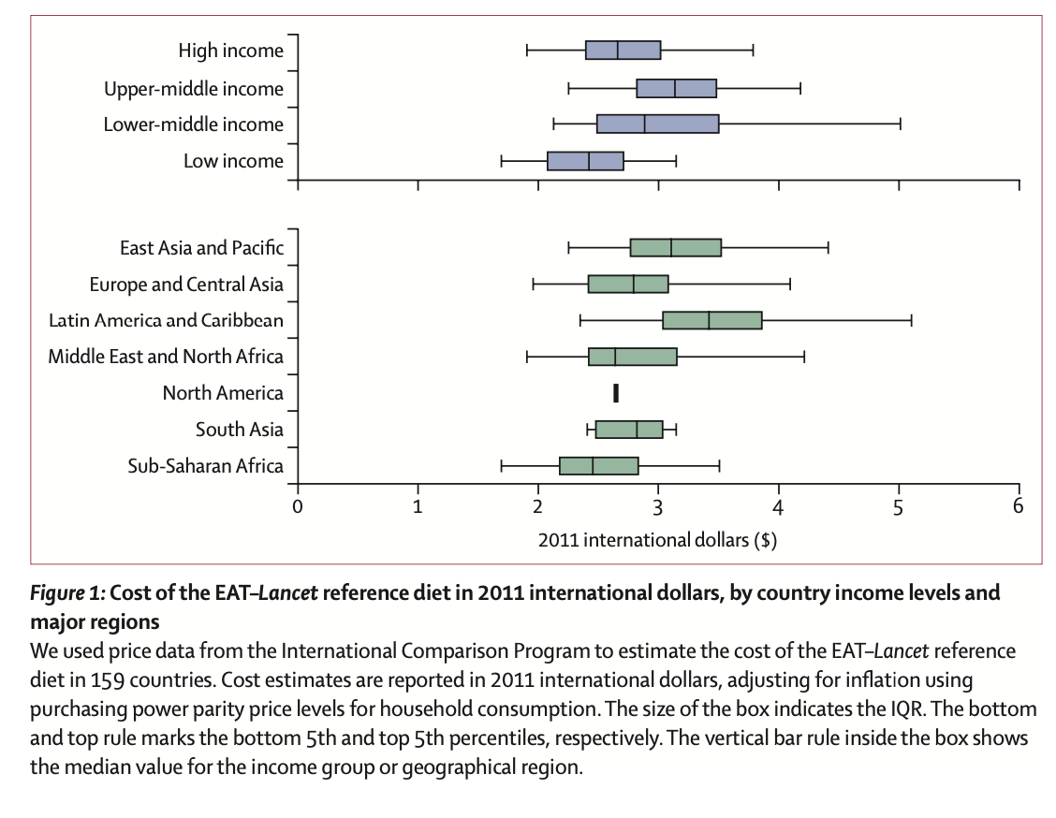

Slide 23
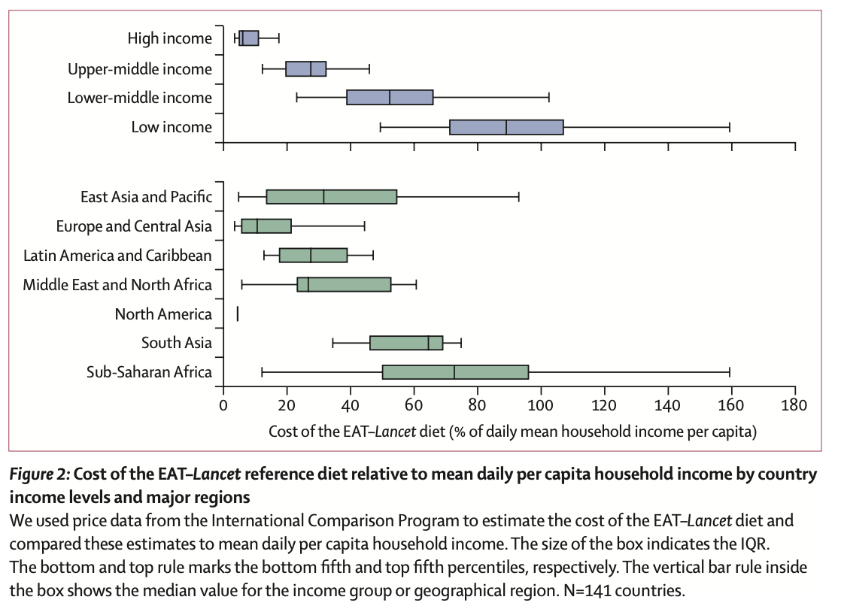
Notes:
ATTENTION : to MEAN per capita (ie. Median is lower)

Slide 24
